Slide 1

Regional Scientific Library in Liberec
PhDr. Dana Petrýdesová
petrydesova@kvkli.cz , www.kvkli.cz

Slide 2
Liberec Library
The largest public library in the Liberec Region..
A modern, open, and interesting space.
An educational, cultural, and leisure-time institution.
A wide range of services for everyone (children, seniors, students).
Basic services:
Borrowing books and other media.
Educational events for schools and the public.
Lectures, workshops, cultural events, Wi-Fi.
Places for studying and relaxing (including modern study rooms).
Café, ...

Slide 3
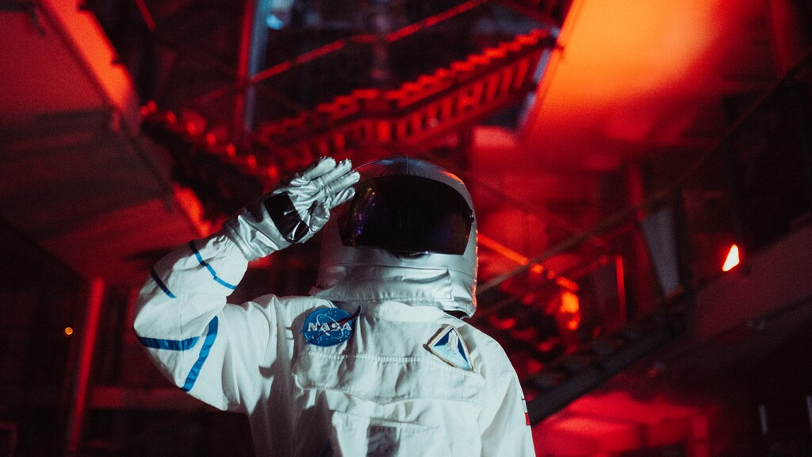

Slide 4
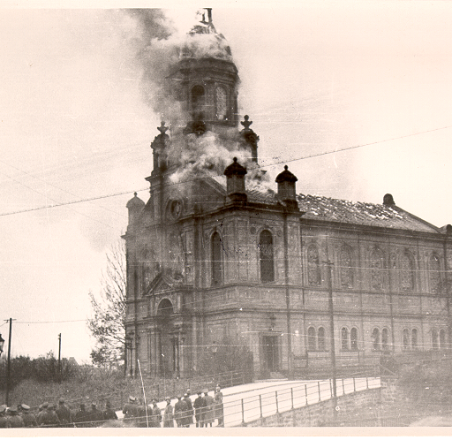
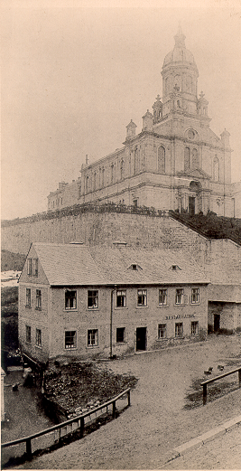
A Library with a story

Slide 5
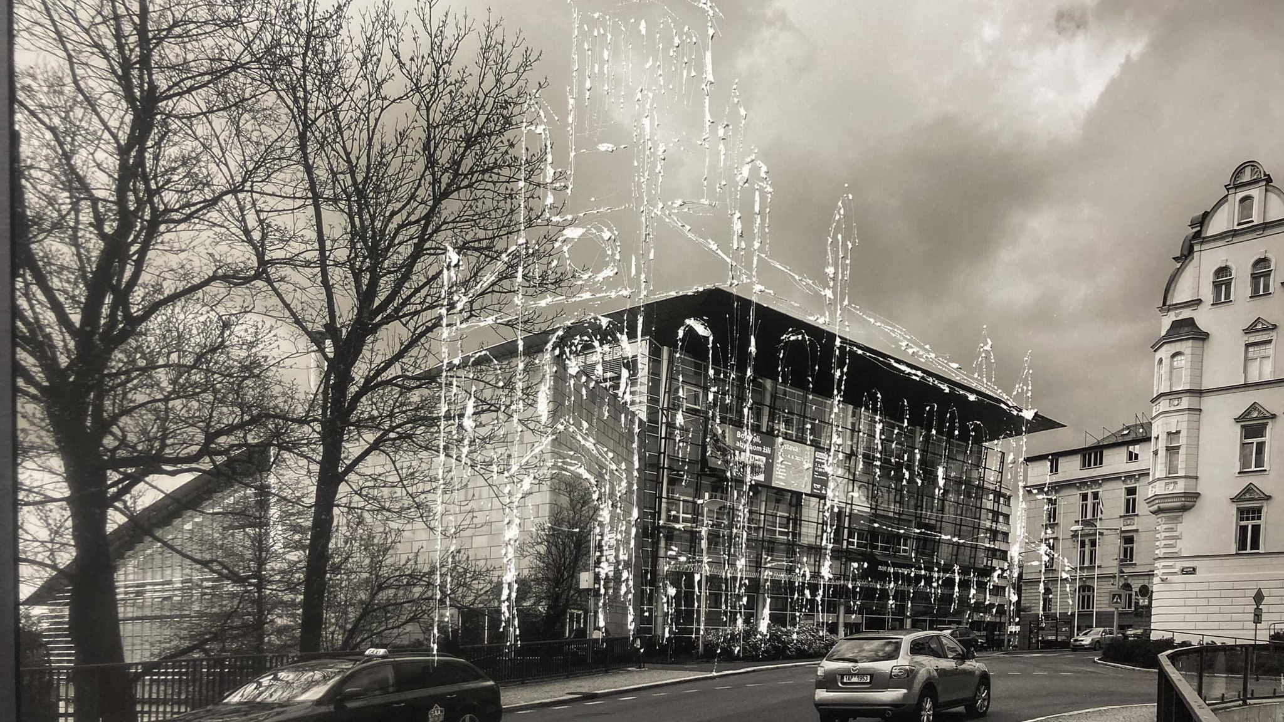

Slide 6
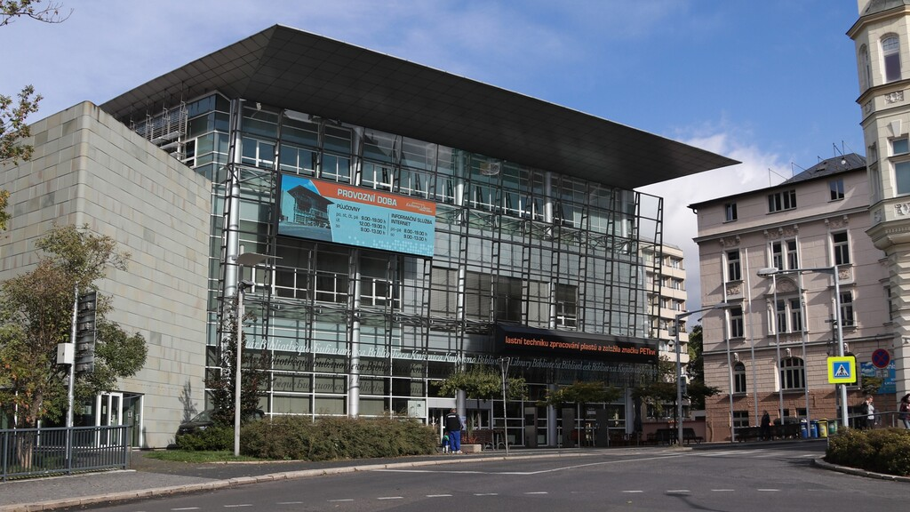

Slide 7
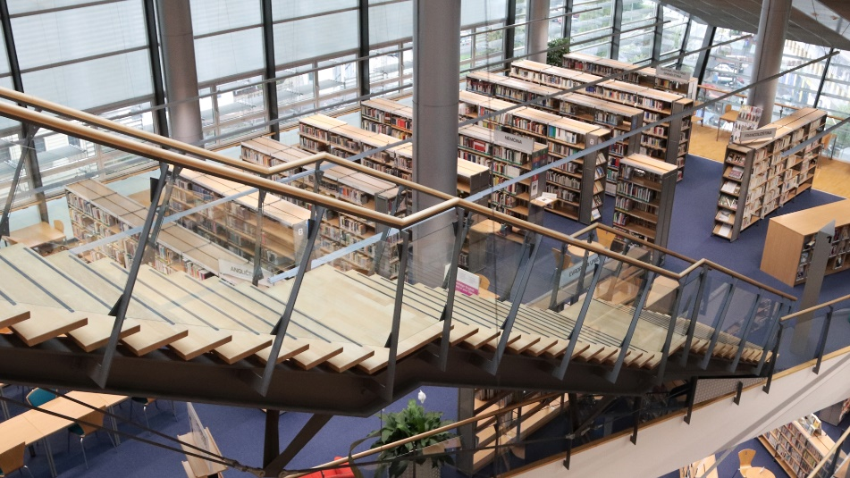
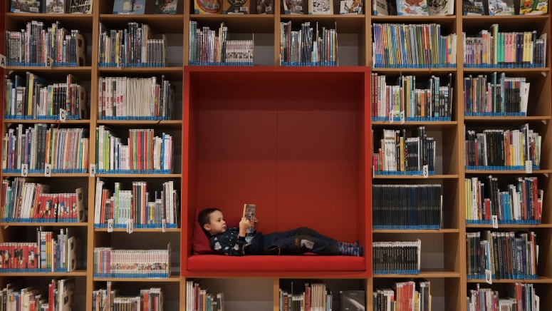
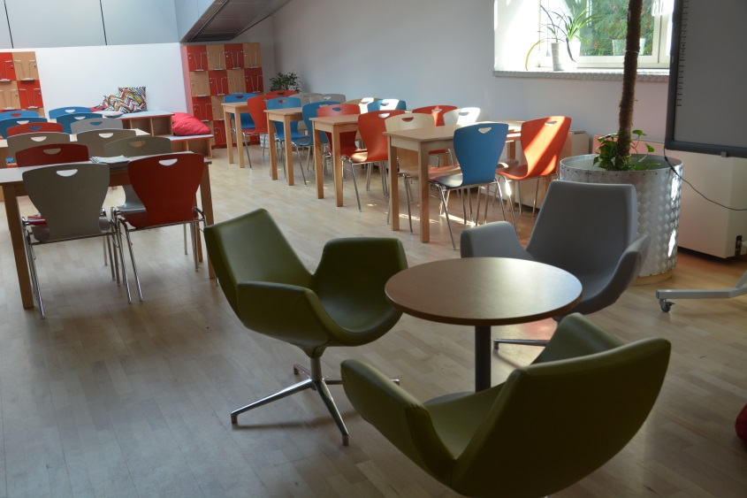
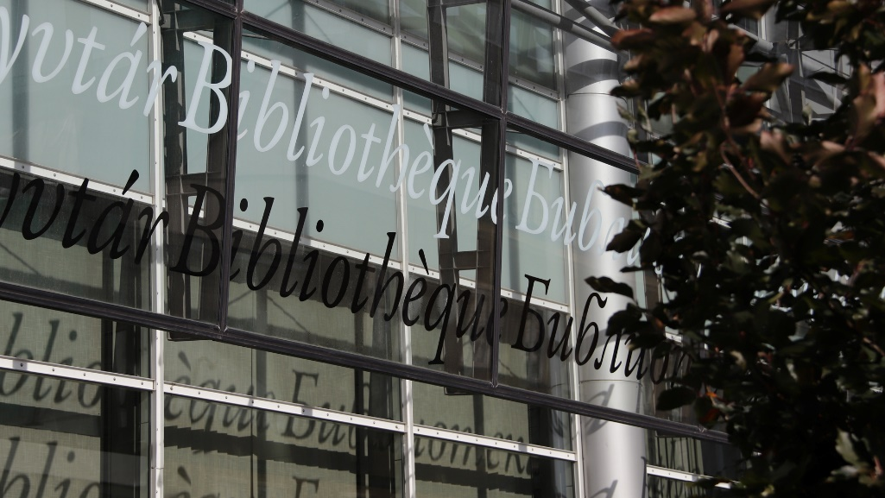
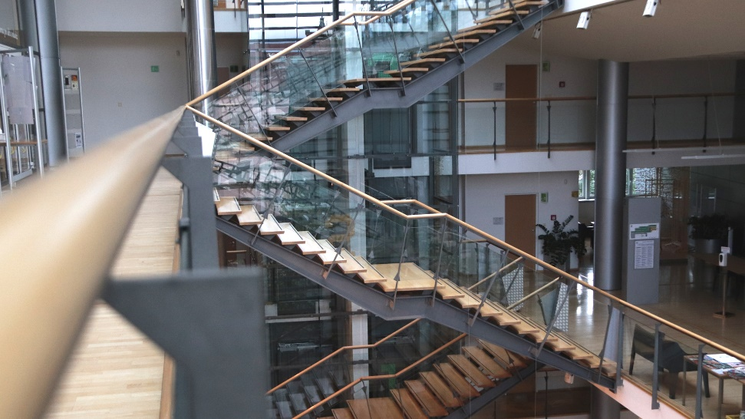

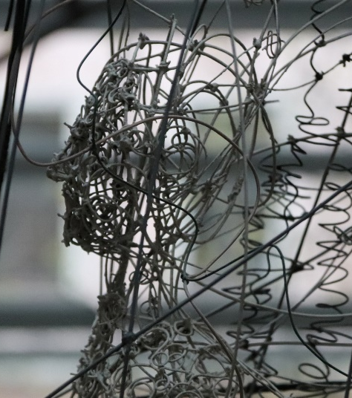

Slide 8
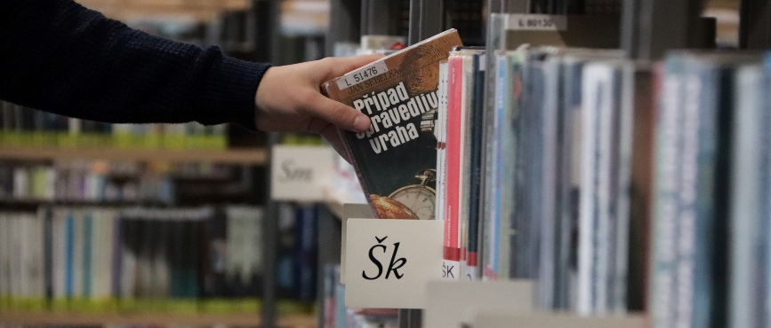
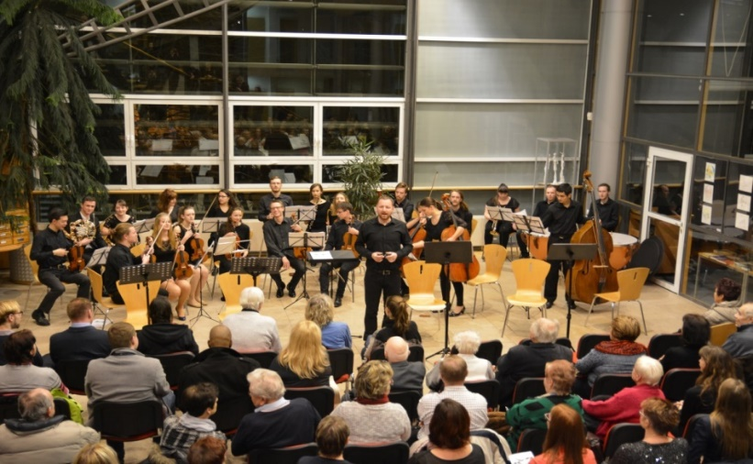
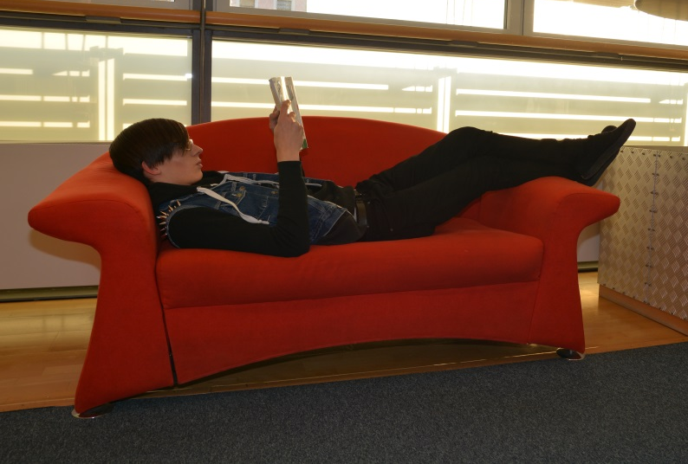
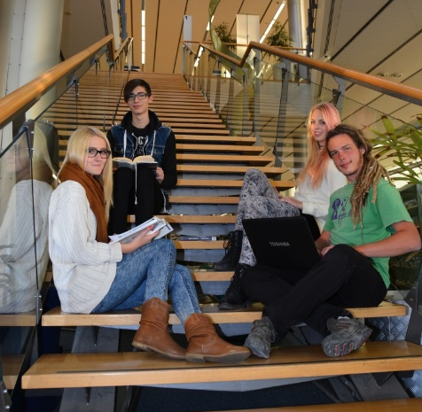
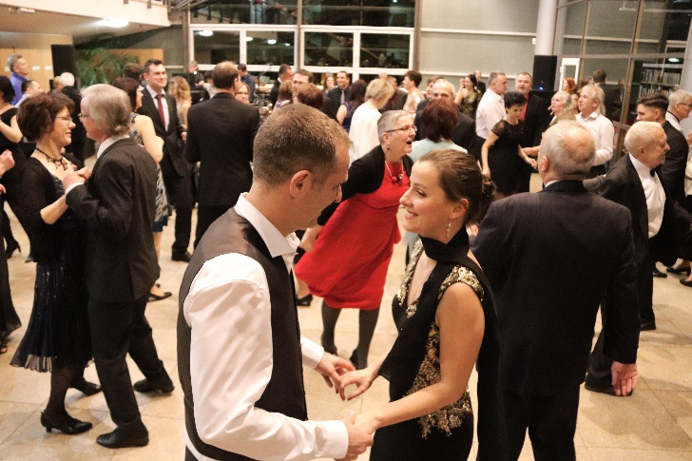
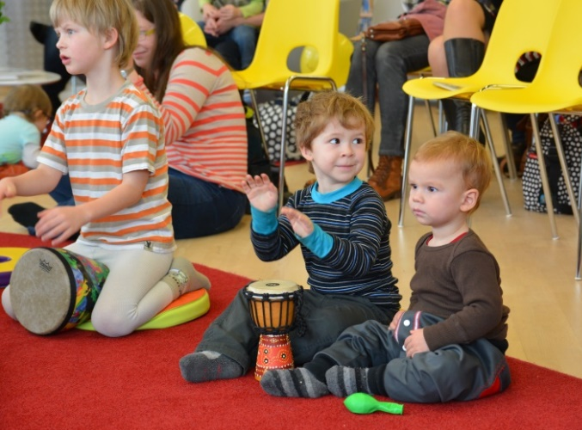
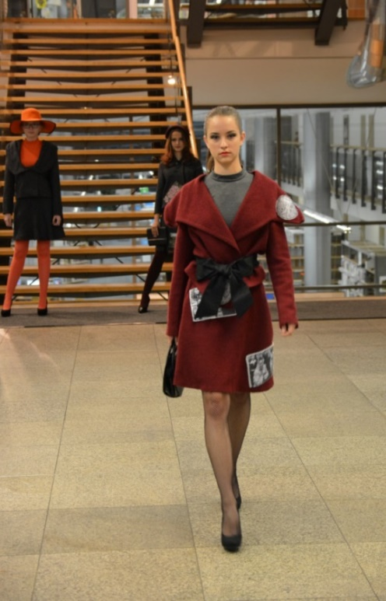
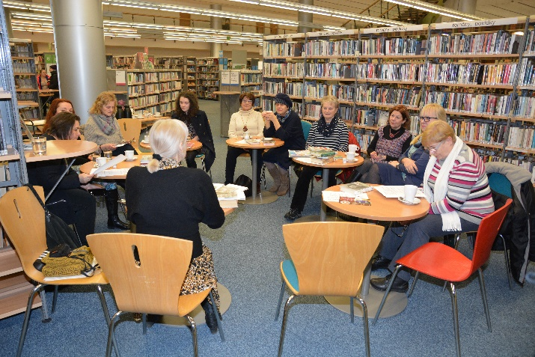
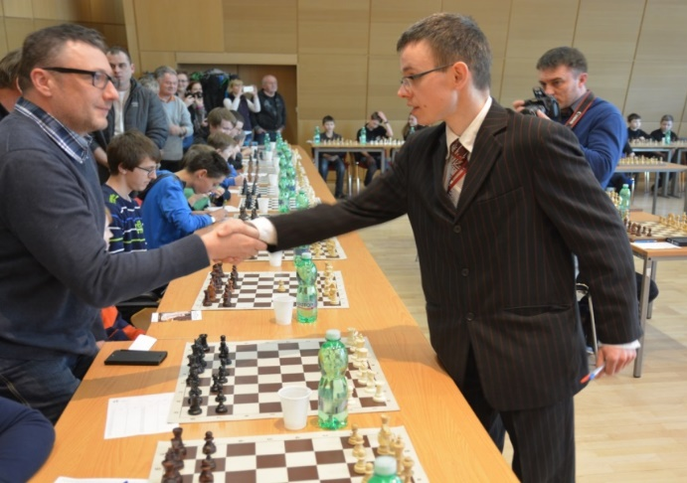
Library

Slide 9
Services for students and young people
Books and other media for studying, including online.
Books for leisure – including comics, manga, young adult, e-books, etc.
Study rooms and study areas.
A place for relaxation and spending free time.
Café.
Creative library – board games, musical instruments to try out, etc.
Concerts, exhibitions, interesting lectures, ...
Activities – escape room, slam poetry, pub quizzes, robotics, 3D printing, cosplay, ...

Slide 10
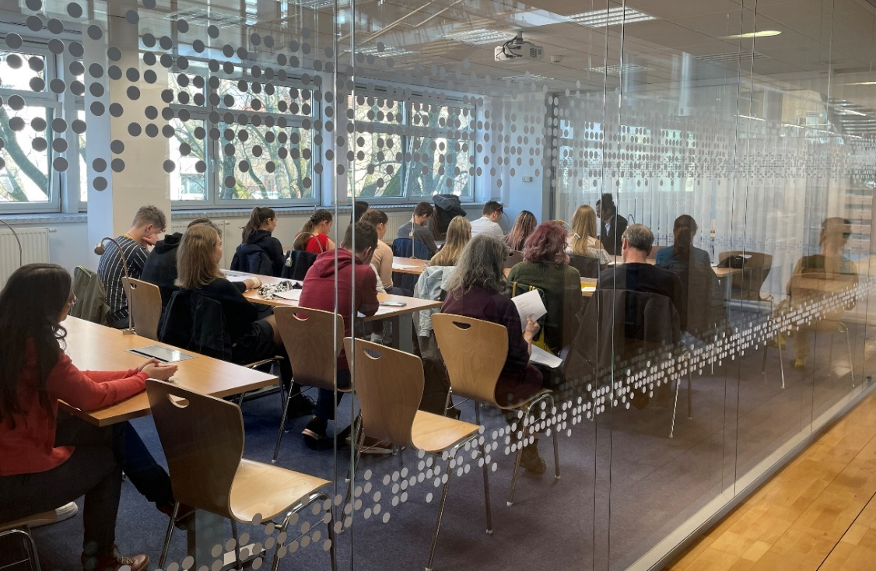
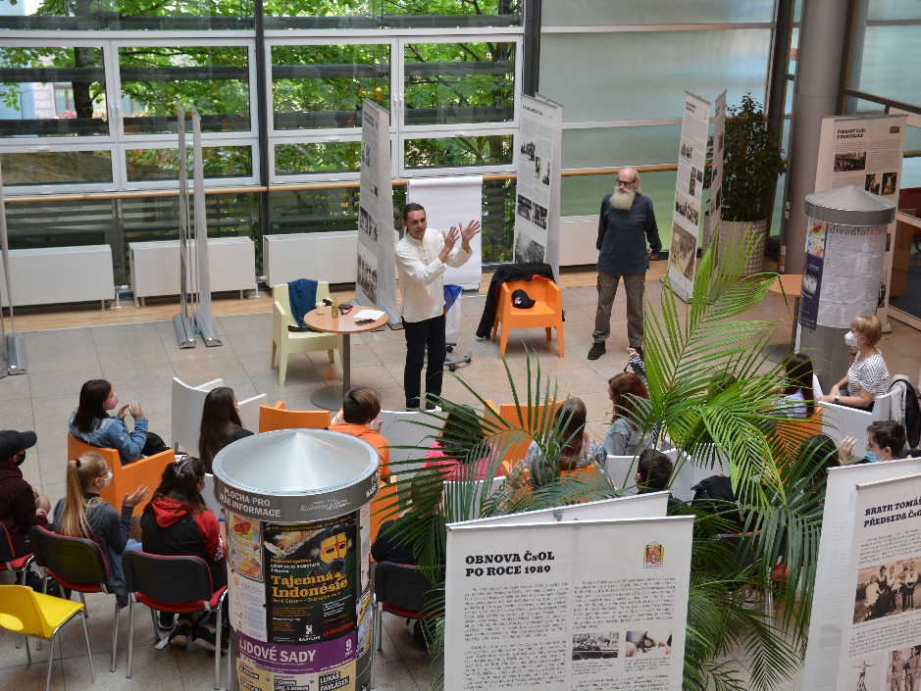
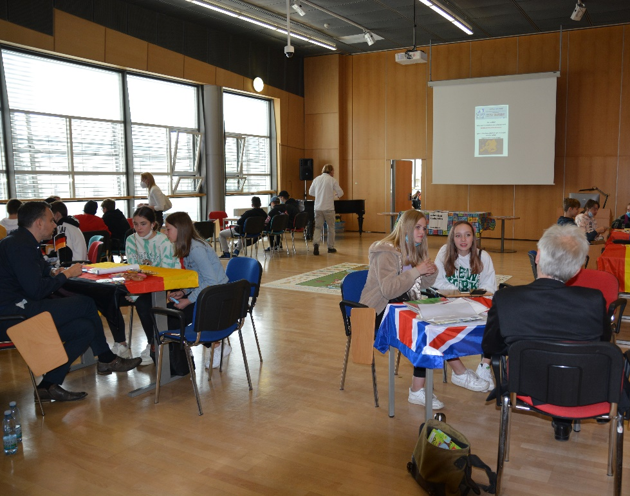
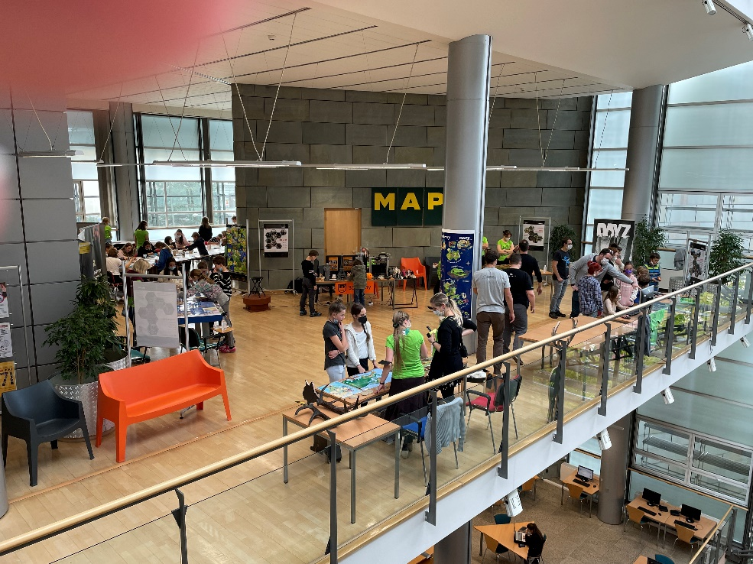

Slide 11
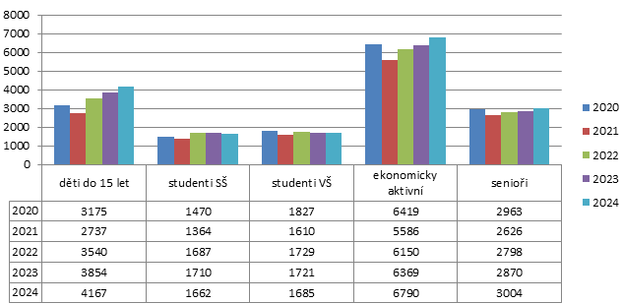
Readers 2020 - 2024

Slide 12

According to statistics, the number of young people who go to the library after the age of 15 is significantly decreasing.
Can you help us change that?

Slide 13
What can you help us with?
Creating an interactive guided tour,
that will offer an interesting journey through the library, guided in understandable language and using the library's space and equipment, game or competition elements, modern means, e.g. mobile phones, applications or web platforms, QR codes, social networks, etc.
The solution may include the design of a new service/services,
supplementing or developing the library's current offering, recommending interior layout and equipment, etc. so that the library "entertains" you, inspires you to visit and spend your free time.

Slide 14
Information about the library
Website: https://www.kvkli.cz/
Information about the synagogue: http://www.kehila-liberec.cz/synagoga.aspx
Social media: Facebook, Instagram, YouTube
Film: https://www.youtube.com/watch?v=337McIZVj5o&t=2s
Virtual tour, photogalery, floor plans: https://www.kvkli.cz/o-nas/virtualni-prohlidka-fotogalerie

Slide 15

Thank you for your attention

